Slide 1
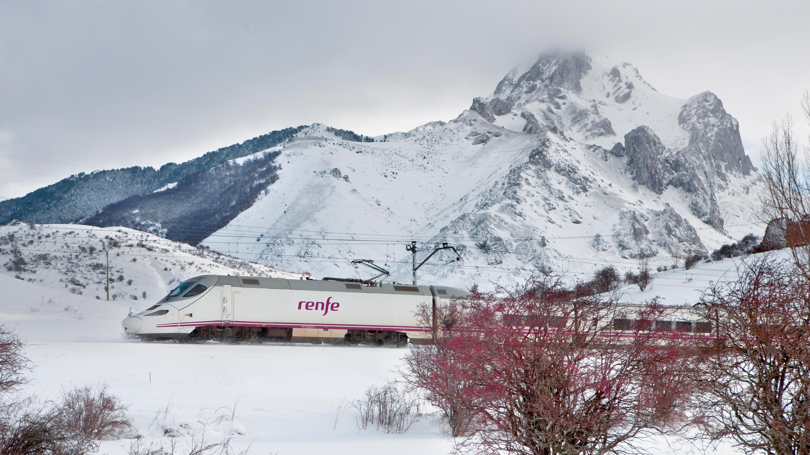


Alta Velocidad Española
Ticket Pricing Prediction Presented by Mayur Kumar
1

Slide 2
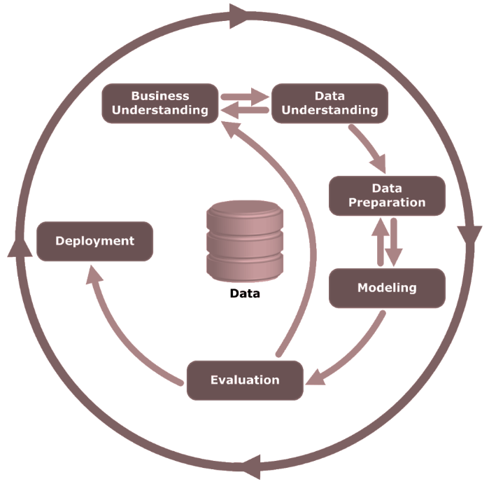
Project Inspiration
Spring Semester in Europe
Wanted to travel cheap. (e.g. 30 EUR round trip flights from Vienna to Milan)
Agonizing puzzle piecing process
Didn’t go to Spain in the end - high AVE ticket prices
Wanted a way to predict prices for given times
Found this dataset on Kaggle, and our team loves it
2

Slide 3
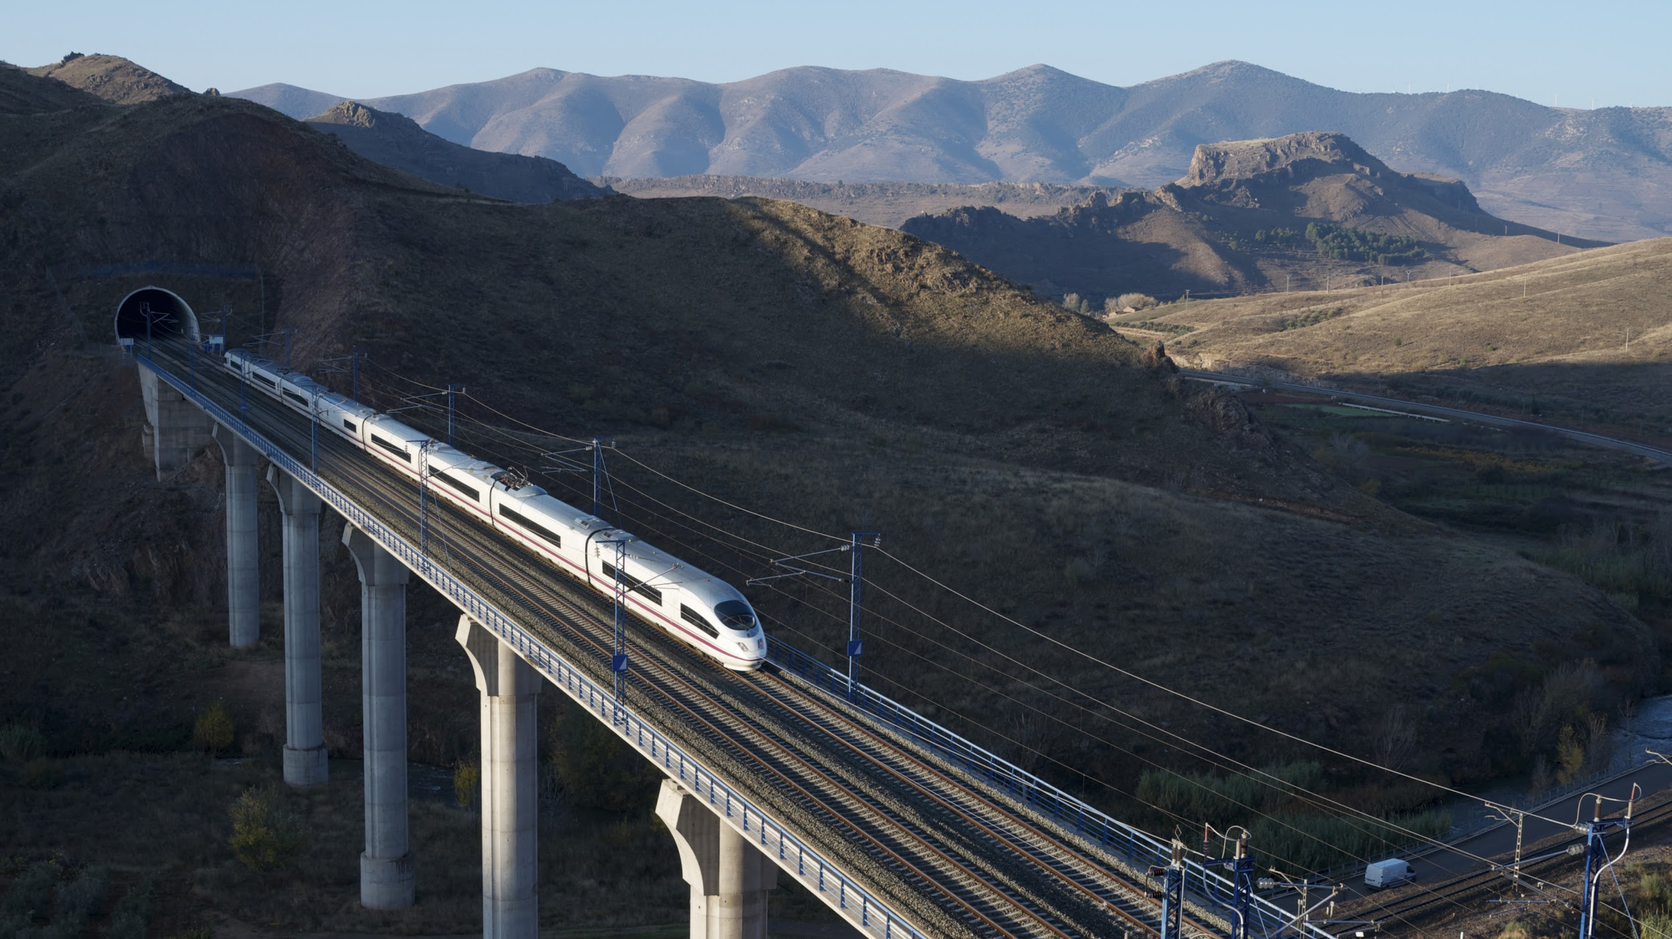
1.
Business Understanding
What are we trying to do? Why?
3
Notes:
Business Understanding (15 points) • Identify and motivate the business problem that you will address. Creativity? Precise statement of problem?
Discuss what is the exact business problem • Discuss how tackling that business problem with data science would add business value • Discuss the typical use scenario

Slide 4

Spain on the World Map

Slide 5
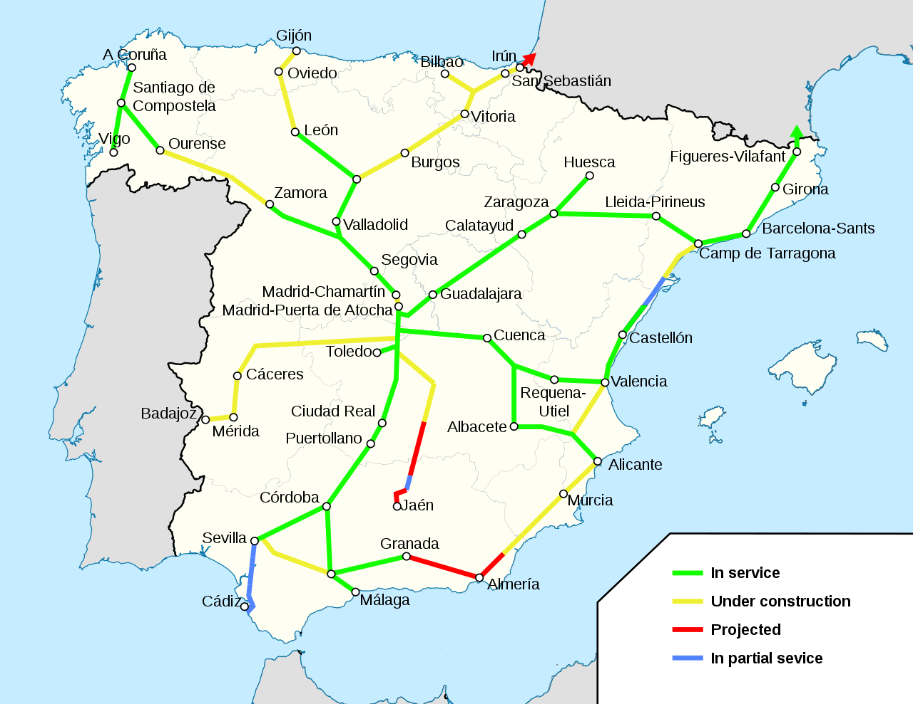
Tourism in Europe
2019 EU tourism statistics:
Over 66% (ages 15-34)
Over 60% (age 35&+)
2.6 trips per year on average
Increasing environmental awareness also boosts train ridership
Source: https://www.railjournal.com/regions/europe/renfe-ridership-growth-continues/
5

Slide 6
Business Problem
Ticket Prices Fluctuate Unpredictably
Finding Cheap Tickets During Peak Times
Data Science Value-Add
- I want to buy a ticket. What price should I expect and are there cheaper tickets near my parameters?
- I need to get home during the summer. When should I buy my tickets and what route is the cheapest?
Using data mining techniques such as kNN, Regression Analysis and Regression Tree to develop a model that accurately predicts ticket price for any AVE trip at any time.
“Can we predict the price of a ticket during the summer if we know when and where the passenger is traveling?”
6

Slide 7
11.10 Million AVE Riders in 2019
74.63 €
41.42 Million EUR Saved
With 4.2% Year on Year growth
Average AVE ticket price*
If we can help passengers save on average just 5%
* Calculated based on our dataset
7

Slide 8
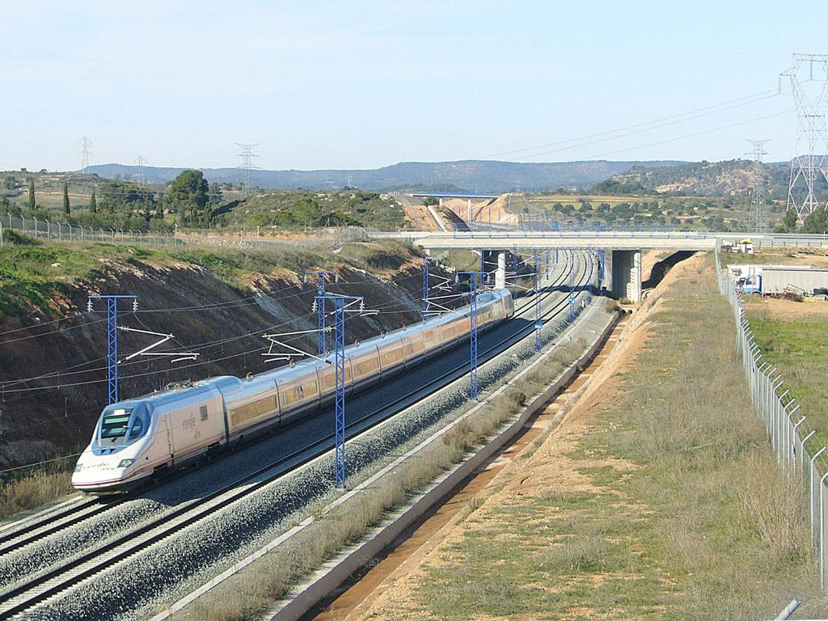
2.
Data Understanding
The numbers, what do they mean?
8
Notes:
Data Understanding (15 points) • Identify and describe the data (and data sources) that will support data mining to address the business problem. Include those aspects of the data that we routinely talk about in class and/or in the homework assignments.
Data Details • Give a short description of the data you are planning to use. • How have you obtained the data? What is the source of the data? • Please provide as much as you can from the following information: o Load the data into RapidMiner/Python o Number of examples? o Number and types of variables? o If you are planning on a classification problem – what is the ratio of the most prevalent class? o If you are planning on a regression problem – what is the distribution of the target variable?e?

Slide 9
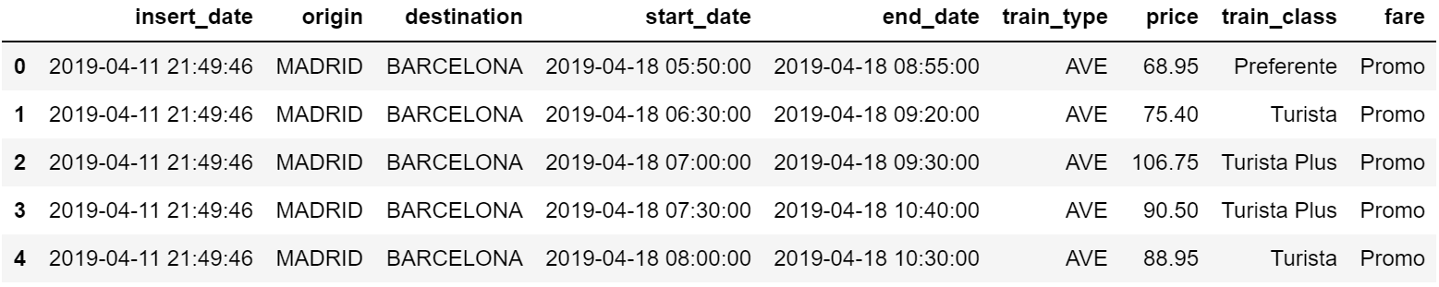
Data Source
Source: https://www.kaggle.com/thegurusteam/spanish-high-speed-rail-system-ticket-pricing
Kaggle dataset on the Spanish High Speed Train Service (Renfe AVE).
Data on the summer of 2019 (Apr. - Oct.)
Shape of the original data: ( 7.67 million rows x 9 columns ).
9

Slide 10
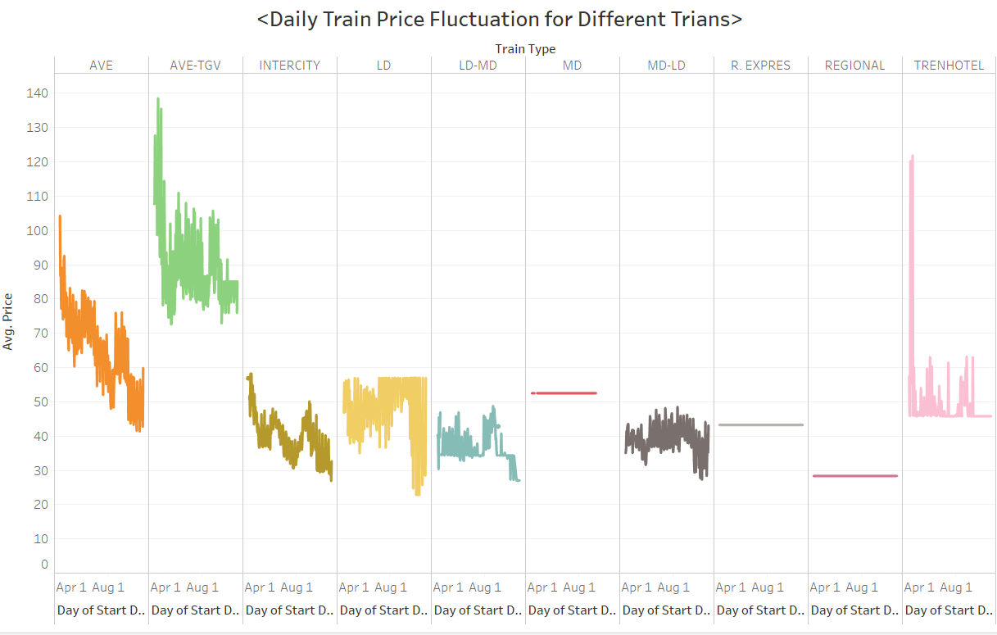
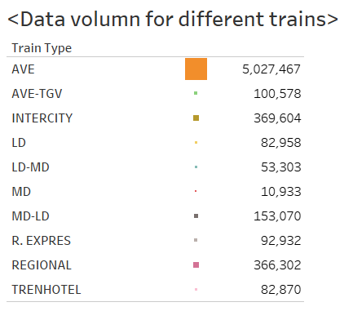
Initial Data Exploration Pt. 1
Fixed price for some trains; our AVE train data is 68% of the whole data.
10

Slide 11
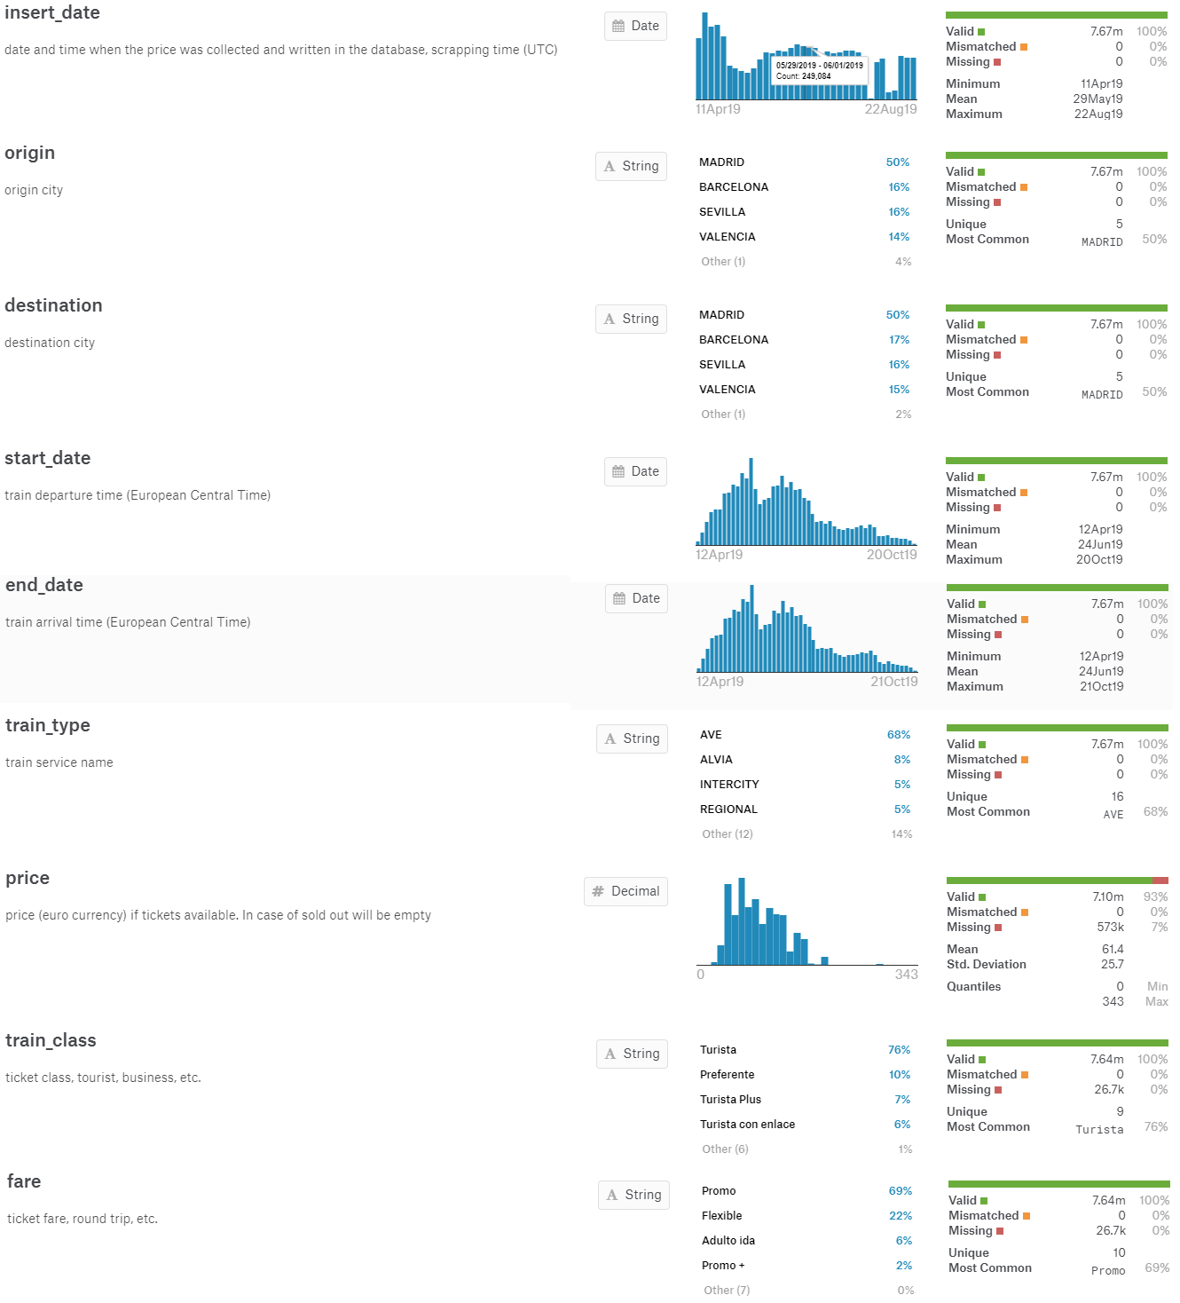
Initial Data Exploration Pt. 2
The majority of the prices fall between 10 EUR and 110 EUR, with extreme values to the right:
11

Slide 12
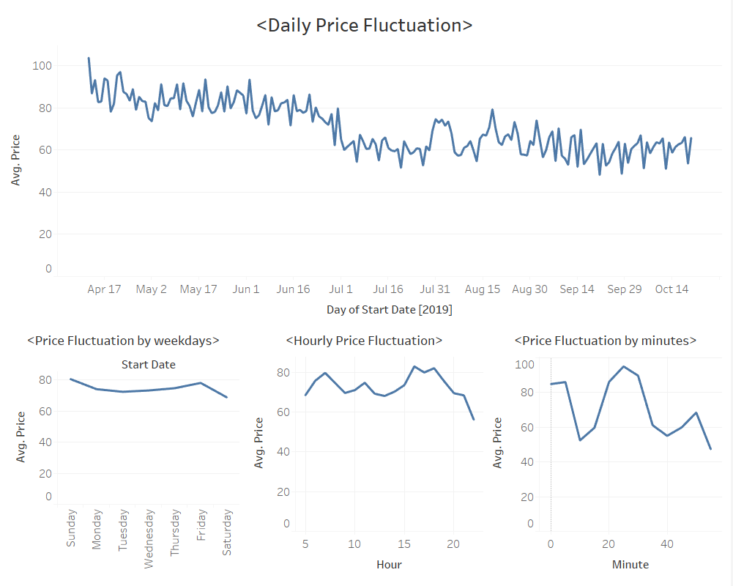
Time Related Fluctuations
Price fluctuation based on time across dataframe period
12

Slide 13
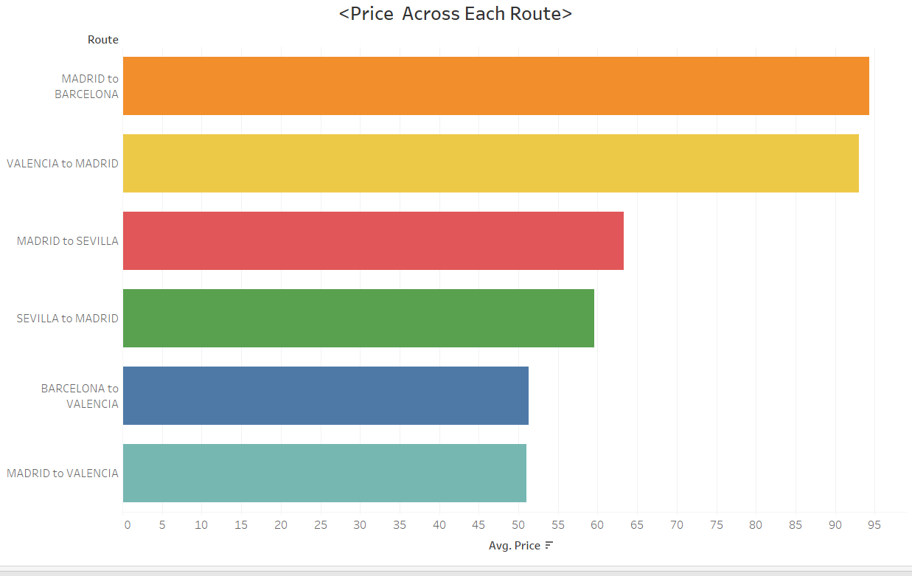
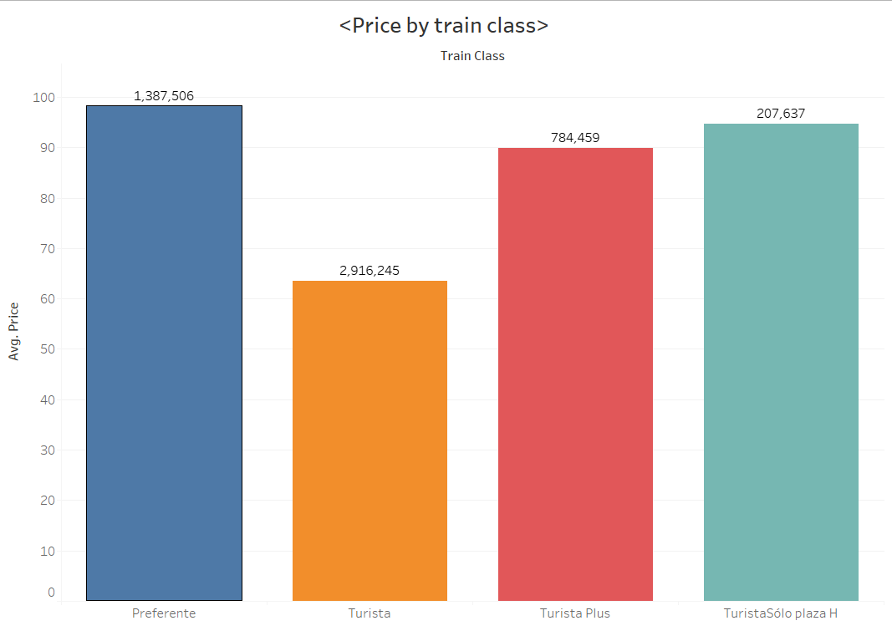
Average Price of Each Route & Class
13

Slide 14
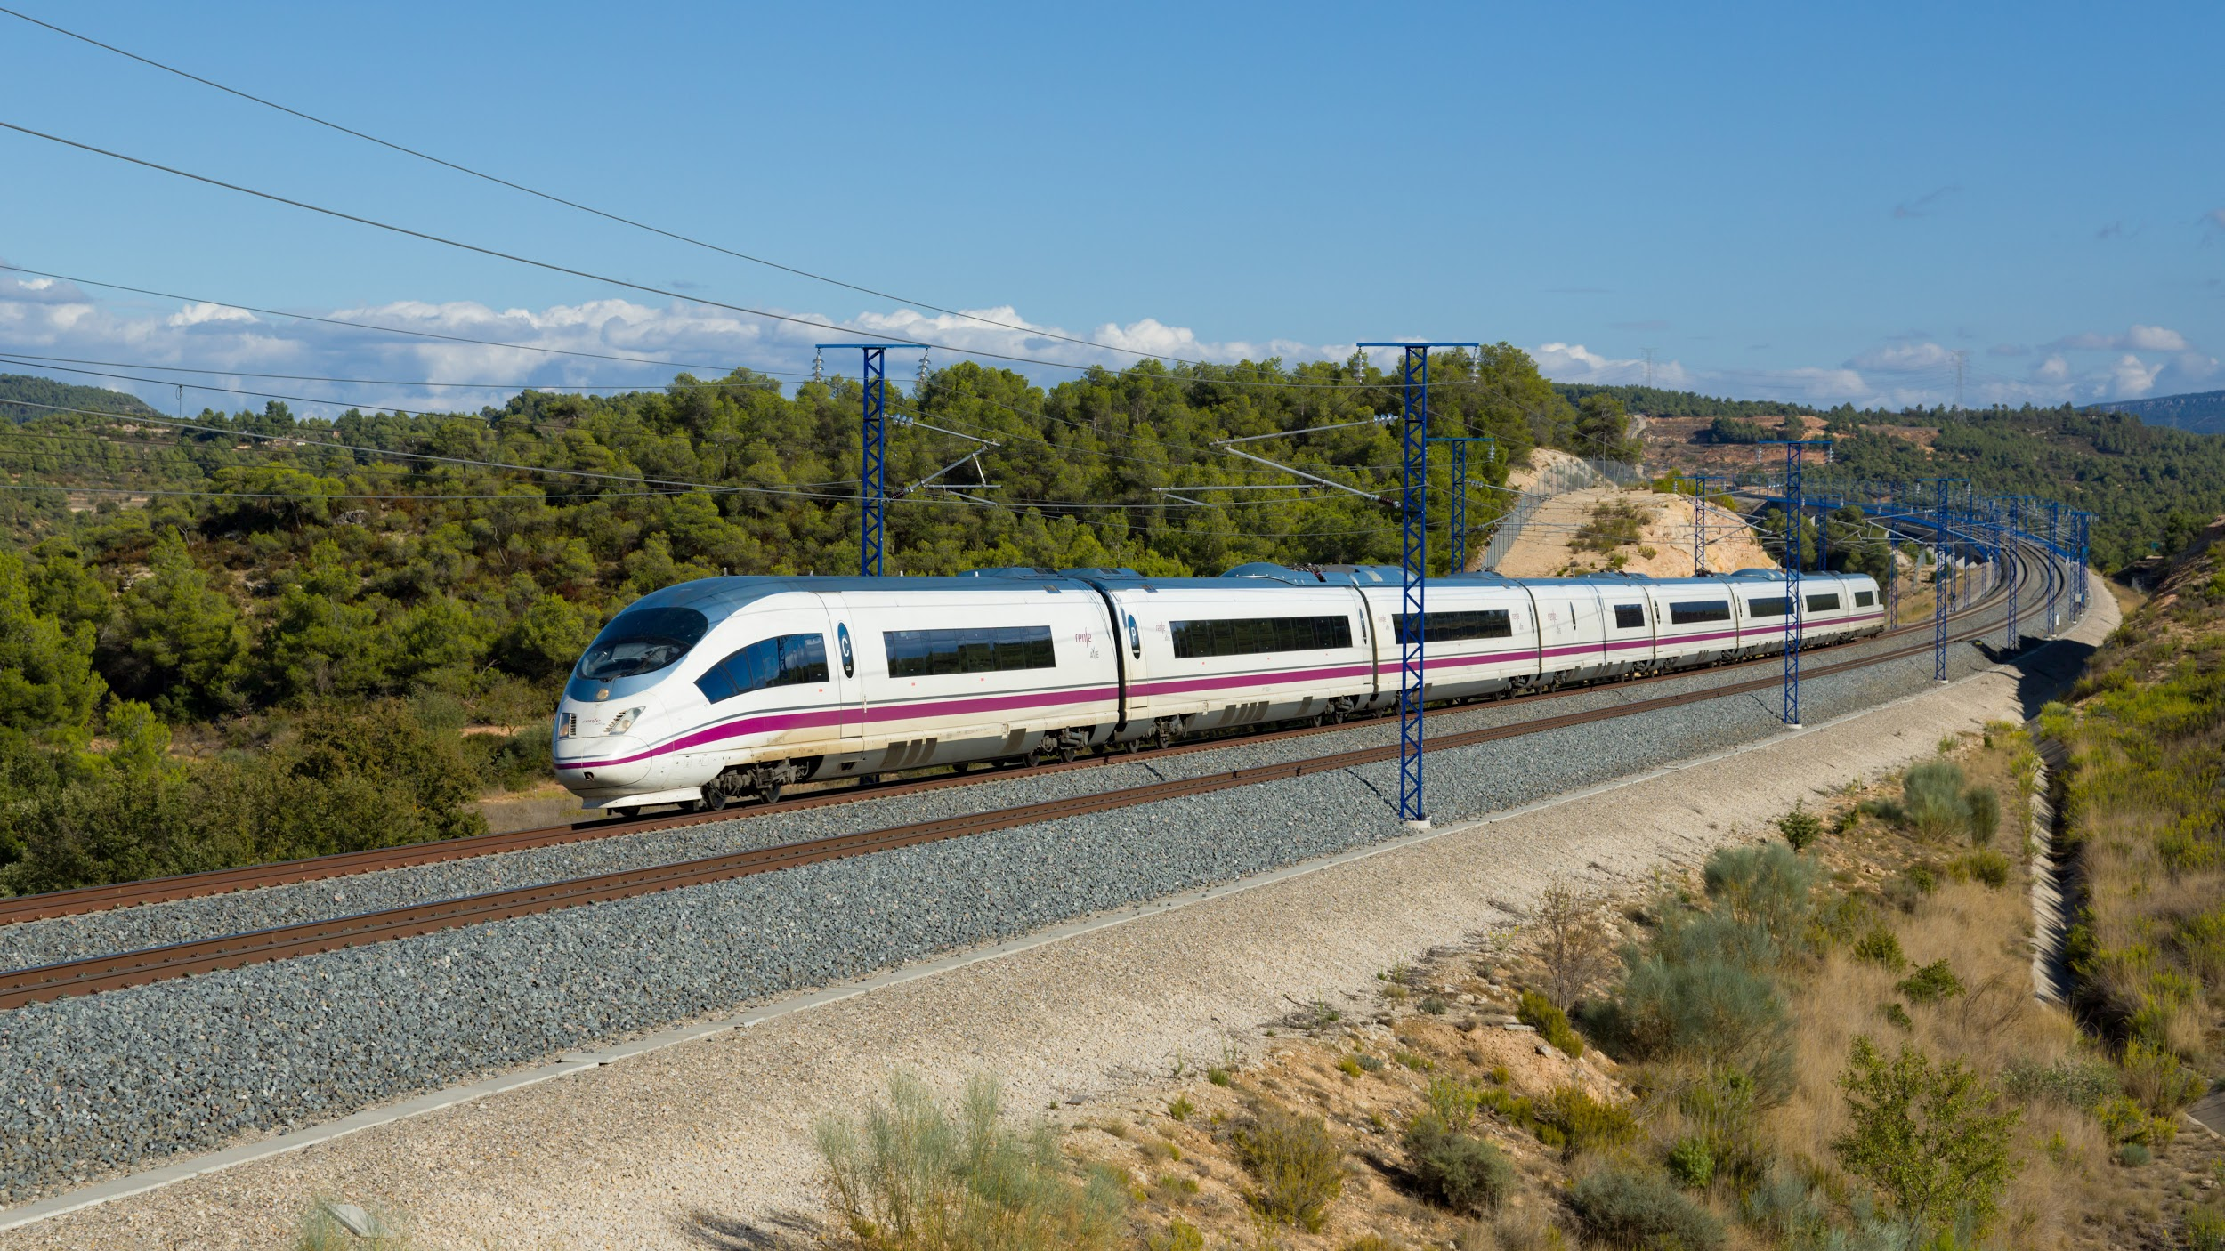
3.
Data Preparation
Sort, clean, divide, transform, we did it all.
14
Notes:
Data Preparation (15 points) • Specify how you will integrate these data to produce the format required for data mining.

Slide 15
Data Preparation Process
Data Cleaning
Feature Engineering
Modeling
This was a very iterative process, as we went back and forth between modeling and feature engineering several times.
15

Slide 16
Data Cleaning
Drop all rows containing nulls
7.67 million entries → 7.10 million entries
Remove insert_date
With insert_date removed, we dropped all duplicate entries.
7.10 million entries → 89,515 entries
Removed all non-AVE train entries
68% are AVE
89,515 entries → 70,963 entries
16
Notes:
We removed all N/A, missing or infinite values from the dataset.
This reduced our dataset from 7.67 million entries to 7.10 million.
We then removed the insert_date variable as it only represents when the data was scraped, which is not relevant for price prediction.
With insert_date removed, we dropped all duplicate entries.
This reduced our dataset from 7.10 million entries to 89,515 entries.
While all trains in this dataset are part of the AVE network, only 68% of the data are actual AVE trains. Removed all non-AVE train entries.
This reduced our dataset from 89,515 entries to 70,963 entries.

Slide 17
Feature Engineering
Attempted feature engineering on numeric variables
Created year, month, day, hour, minute and day of the week categorical variables
Created an algorithm that checks whether departure/arrival date is a holiday
Two binary variables
Converted origin and destination variables into “route” variable
Enables us to use fewer dummy variables while capturing the same information
Created a travel_time variable representing the duration of the trip
17
Notes:
We tried taking the log, square-root and cube-root of every numeric variable to make them more normally distributed

Slide 18
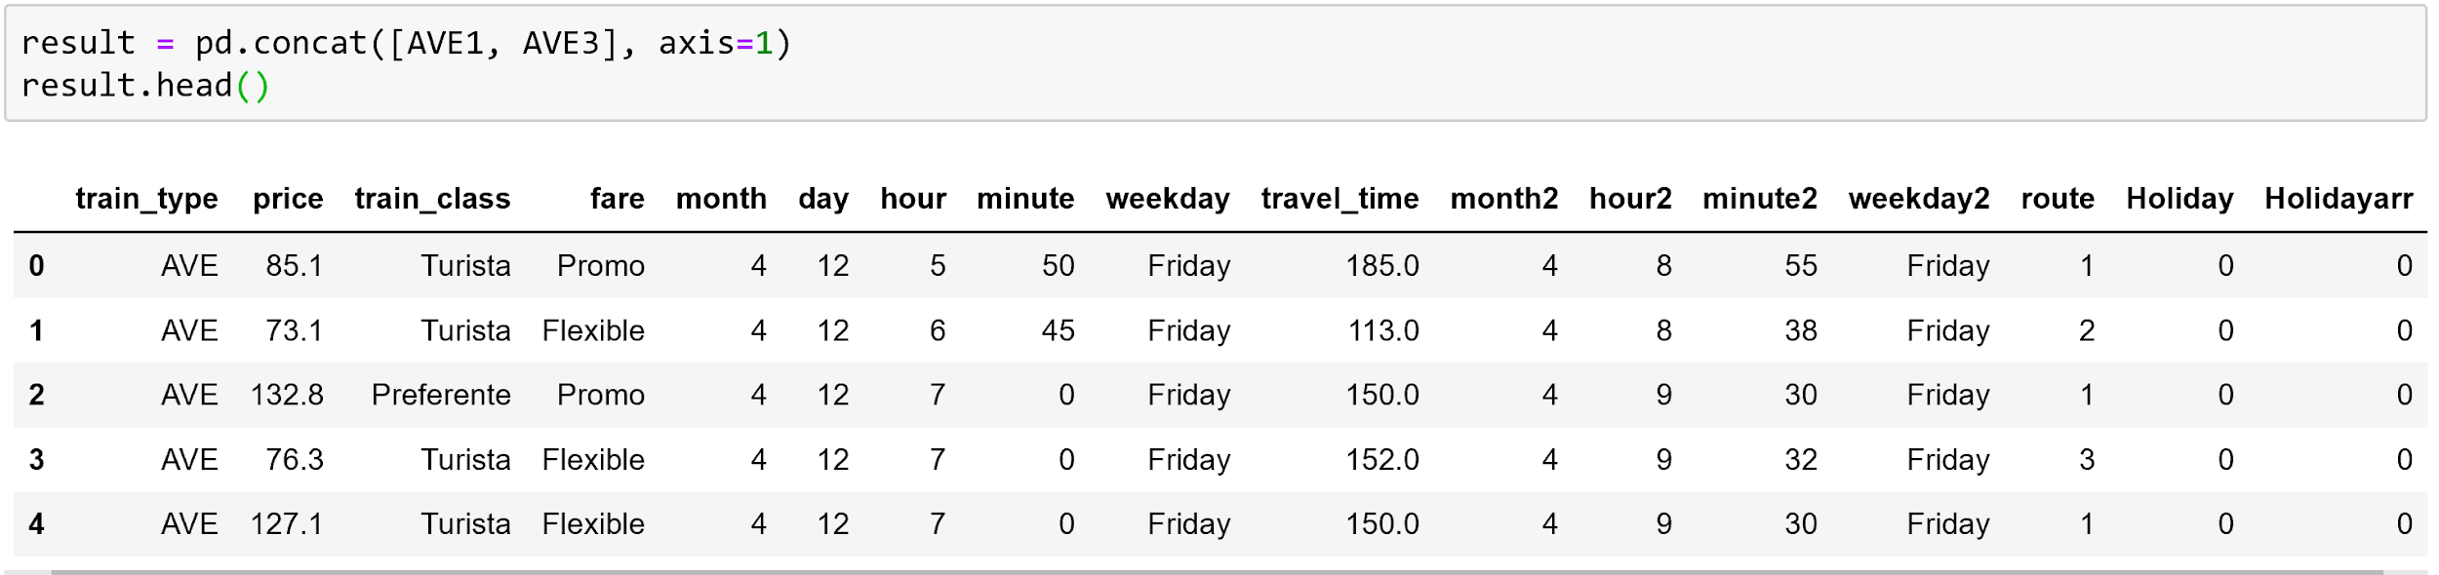
Final Cleaned Data
Prior to converting all categorical variables into dummy variables
70,963 entries, 16 variables
Post-conversion
70,963 entries, 150 variables
18

Slide 19
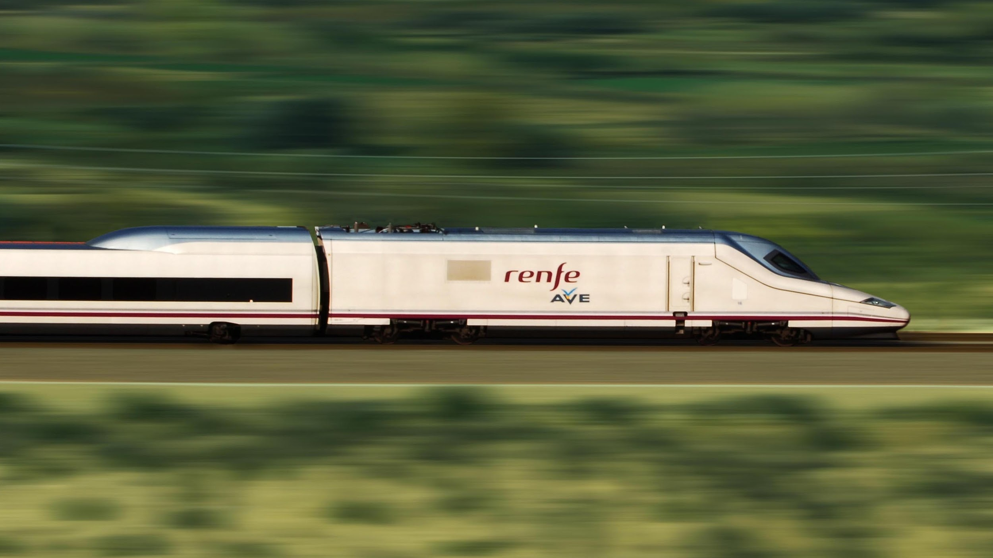
4.
Modeling
Not to be confused with model trains.
19
Notes:
Modeling (15 points) • Specify the type of model built. • Discuss your choices for data mining algorithm: what are alternatives, and what are the pros and cons. • Discuss why and how this model should “solve” the business problem (i.e., improve along some dimension of interest to the firm).
Modeling Ideas • What precisely is the data science problem? (e.g., classification vs regression) • Is the data science task a supervised or unsupervised task? o Supervised tasks are highly encouraged. o Unsupervised learning can be used to explore the data before employing supervised learning. • What is a data instance in your data set? • What might be the target variable? • What features would be useful in predicting the target variable?

Slide 20
Modeling Task
Target variable is known and numeric (train ticket prices)
this is a supervised regression problem.
We used 3 modeling techniques (kNN, Regression Tree and Linear Regression) and compared their RMSE
We used Lasso for linear regression as it outperformed ridge automatically selects features
Reduced number of dimensions in our dataset
20

Slide 21
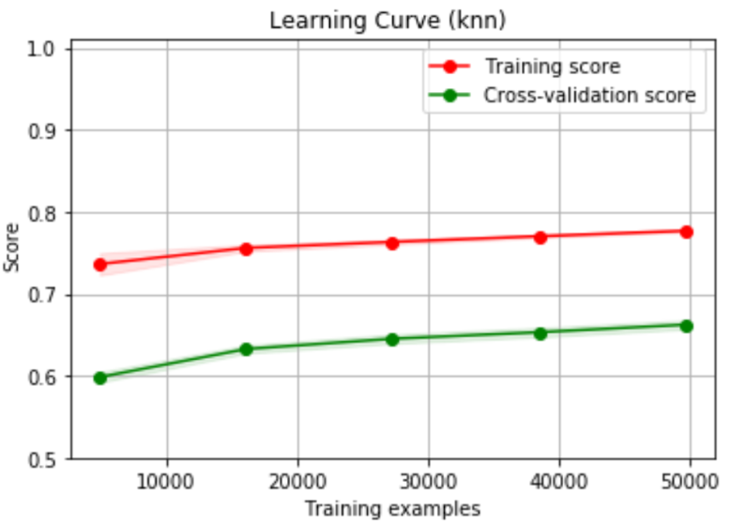
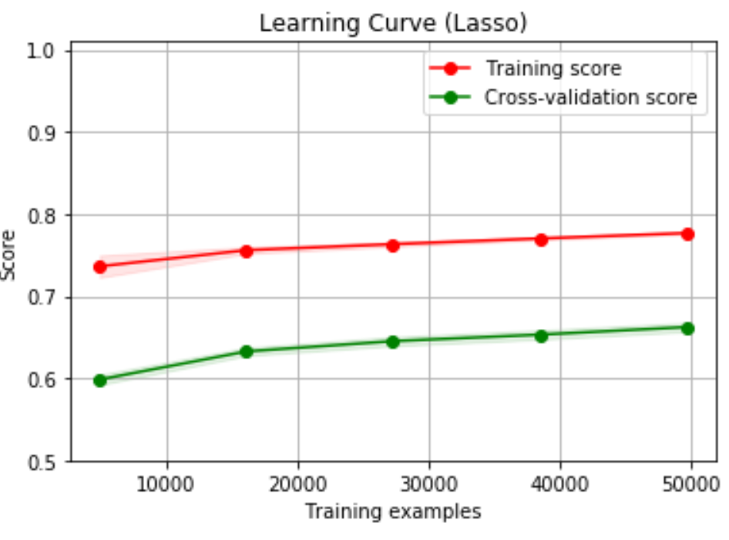
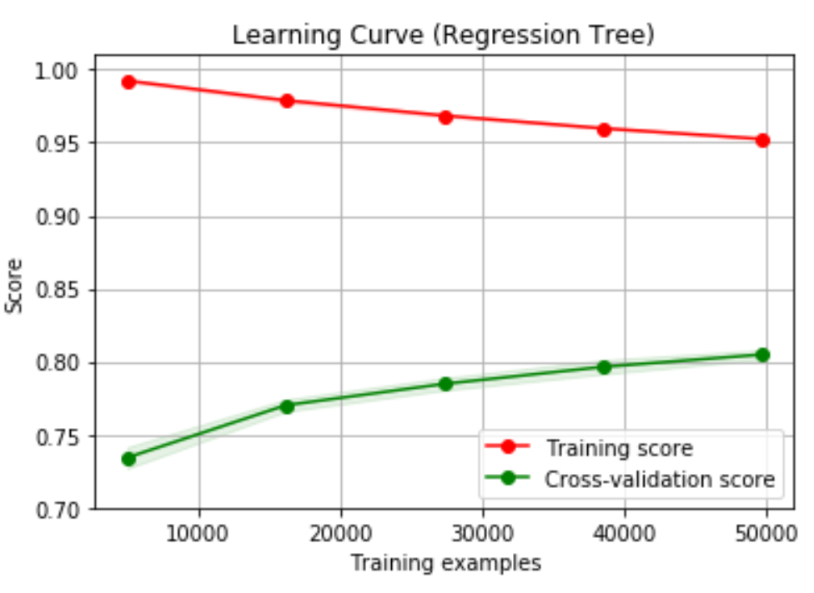
Learning Curves
21

Slide 22
Standard Approach
Gridsearch
Tune Hyper parameters by Nested Cross Validation
for whole dataset
- Best estimator, and best parameters are extracted
Cross Validation
Generalization performance for Whole dataset
22

Slide 23
Cross-Model Comparison
 | Pros | Cons
Lasso Regression | - Automatic feature selection - Avoid Overfitting | - Fails to capture non linear relationship - The model it selects is not intuitive
Regression Tree | - Robust to Categorical variables - Captures non linear relationship better performs better for big data - Interpretability | - Curse of dimensionality
k-Nearest Neighbors | - Intuitive and simple - No assumptions - No training steps | - Time consuming - Curse of dimensionality - Sensitive to irrelevant features
23

Slide 24
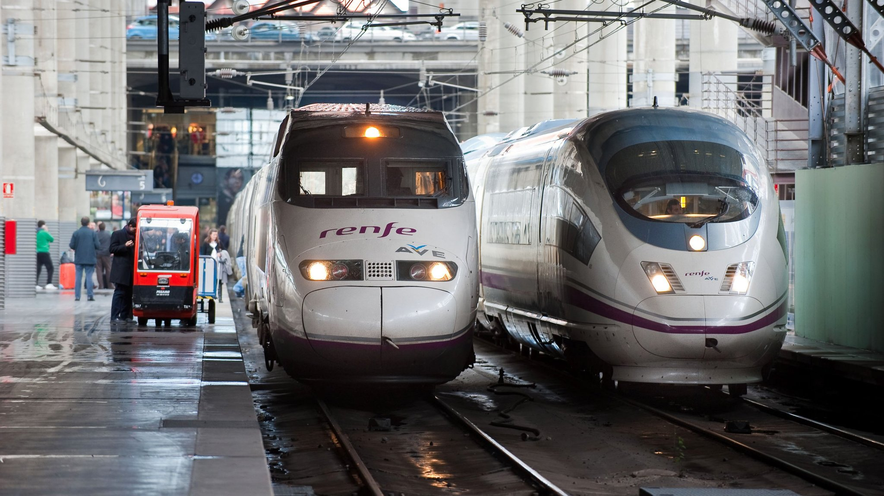
5.
Evaluation
The bane of all college students.
24
Notes:
Evaluation (15 points) • Discuss how the result of the data mining is/should be evaluated. How should a business case be developed to project expected improvement? ROI? If this is impossible/very difficult, why and is there a viable alternative?

Slide 25
PERFORMANCE METRIC
RMSE is chosen as the metric to evaluate our models because it gives us a interpretable value of the accuracy of our prediction, denoted in euros.
In addition, since we did not transform our target variable, RMSE is comparable across all three models.
25

Slide 26
Model Results
 | MAE | MSE | RMSE
Lasso Regression | 22.3 | 380.4 | 19.5€
Regression Tree | 14.1 | 175.5 | 13.2€
k-Nearest Neighbors | 18.6 | 280.1 | 16.7€
Naive | 34.3 | 1040 | 32.2€
26

Slide 27
Projected Improvement/Benefit
ROI needs to outperform WACC for the model to make sense
ROI Calculations:
Cost - investments into data and modeling
Revenue - various methods (e.g. ad revenue)
Selling Points:
More accurate than “guess” or “experience”
No conflict of interest compared to other parties that also do pricing for companies
27

Slide 28
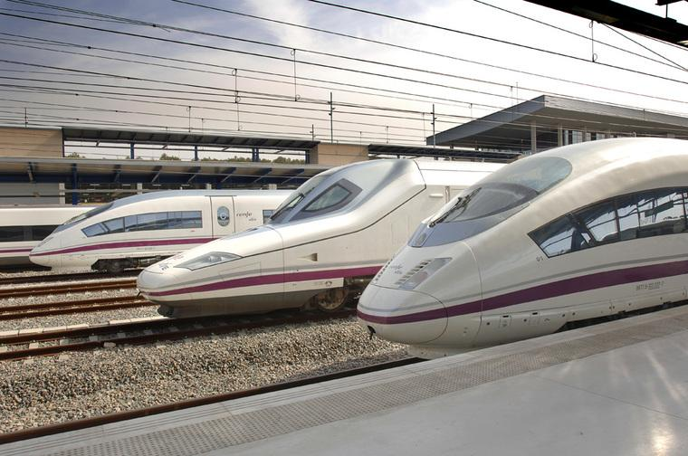
6.
Deployment
Where predictions hit the real world.
28
Notes:
Deployment (10 points) • Discuss how the result of the data mining will be deployed. • Discuss any issues the firm should be aware of regarding deployment. • Are there important ethical considerations? • Identify the risks associated with your proposed plan and how you would mitigate them

Slide 29
Potential Business Model
Service:
Evaluate if ticket is over/under priced compared to market price given a set of inputs
Search for possible time/location combinations given price as input
Revenue:
If prediction >= market price, advertisement on complimentary services (e.g. hotel, tour groups, etc.)
If prediction <= market price, advertisement on substitute services (e.g. bus, flights, car rental, etc.)
29

Slide 30
Deployment Concerns
Model may depreciate due to:
Macro trends
Tech Innovation
Consumer preferences
New train routes
Social-economical changes
Mitigation plan:
Regularly re-collect and re-running our model
Highly competitive field, conglomerates fighting for pricing market share:
(ironically just to collect more data)
Better employees and funding
Mitigation plan:
create competitive advantage by leveraging our small status
Take an ethical stance (Kaldi’s vs Starbucks)
30

Slide 31
Ethical & Legal Concerns and Risks
Minimal, as our model benefits consumers and work with non-sensitive information
Potential data/user privacy problems
Potential targeted marketing consequences
Solution:
Hire a data privacy company to oversee data security
31

Slide 32
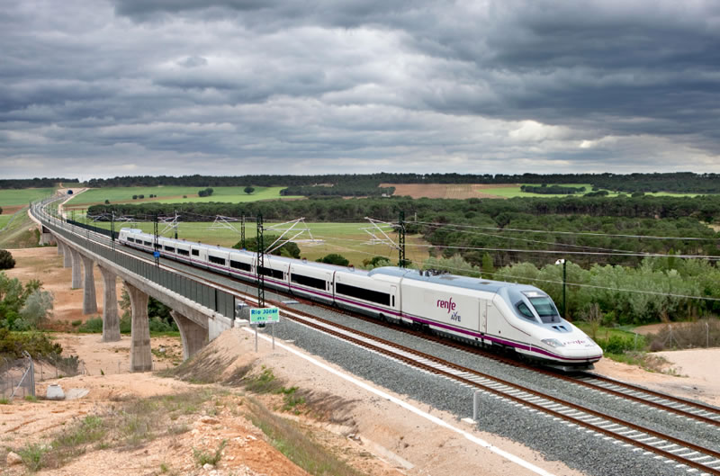
7.
Afterthoughts
There’s always room for growth.
32
Notes:
Overall (15 points) • Presentation, communication.

Slide 33
Future Improvements & Extensions
Current model is provides B2C solution, but can also be easily converted to a B2B solution
E.g. help Renfe price tickets for future routes
Model can be adapted to predict year round ticket price with more data
Unable to do recursive feature elimination for our kNN model due to technology limitation
a single kNN run took almost 2 hours
33

Slide 34
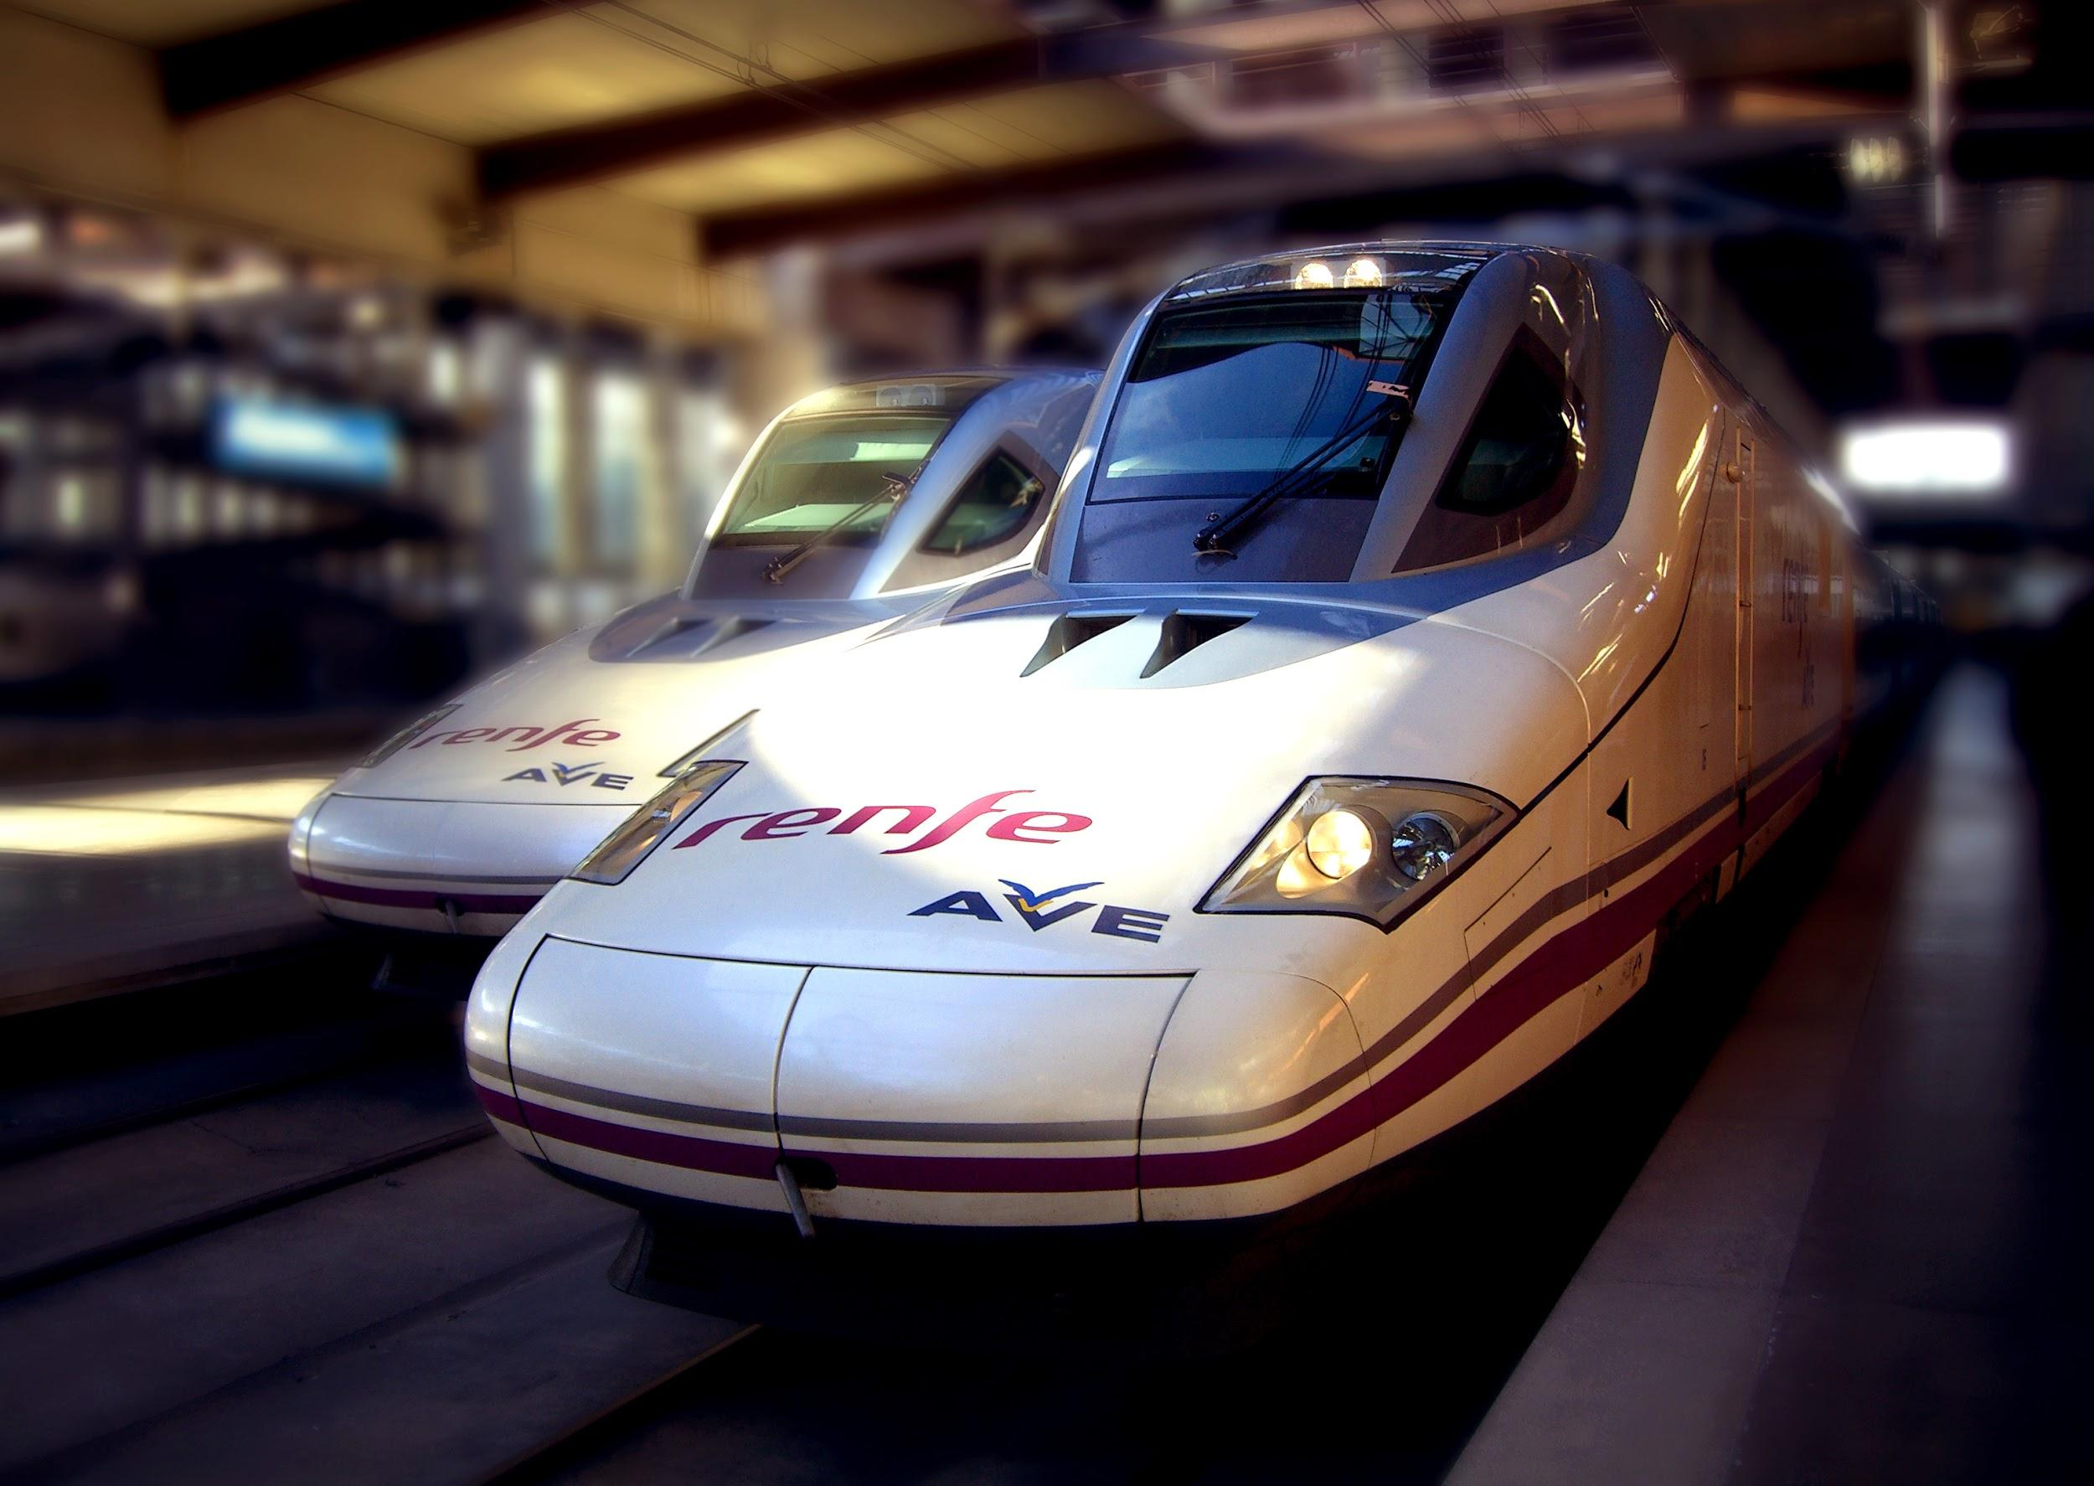
Thank You!
We are Seal Team 6
Questions & Comments?
34

Slide 35
8.
Appendix
I’m glad you asked!
35

Slide 36
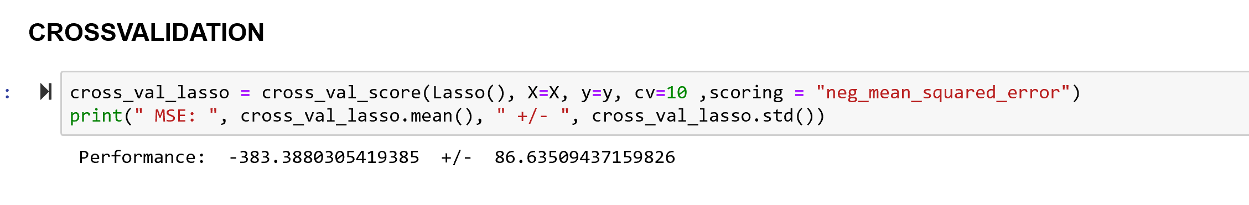
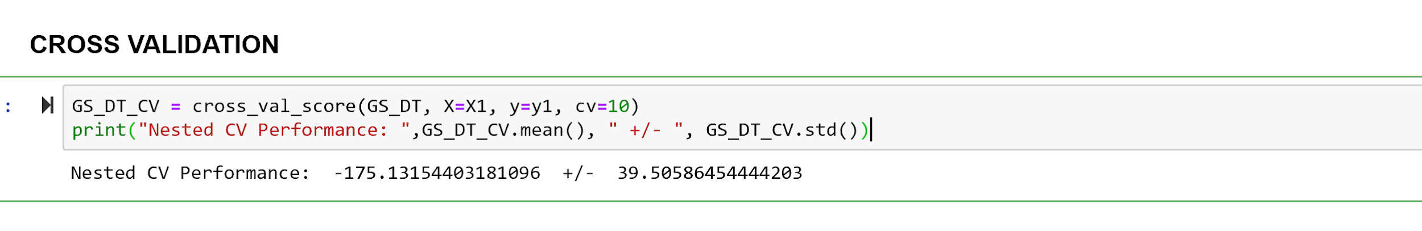
Model Selection
Results:
Lasso
Regression Tree
kNN (see next page)
36

Slide 37
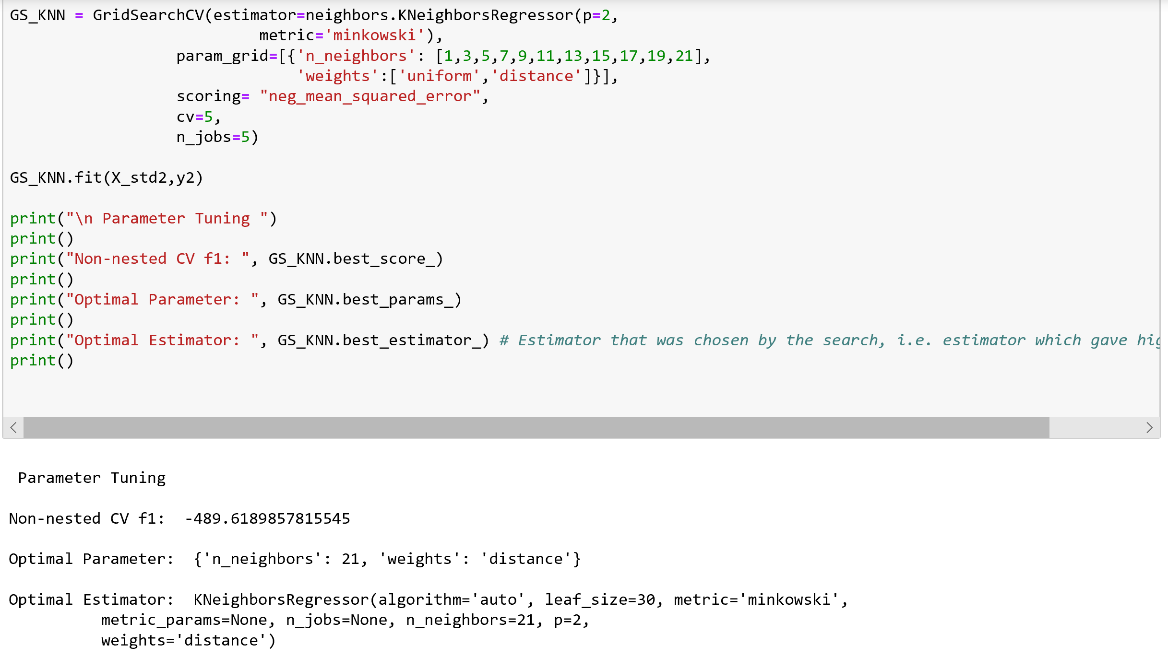
k-NN
37

